Slide 1





HangulTrip
Partnership Proposal
A travel-style Hangul service for Korean learners in India
hangultrip.cloud

Slide 2
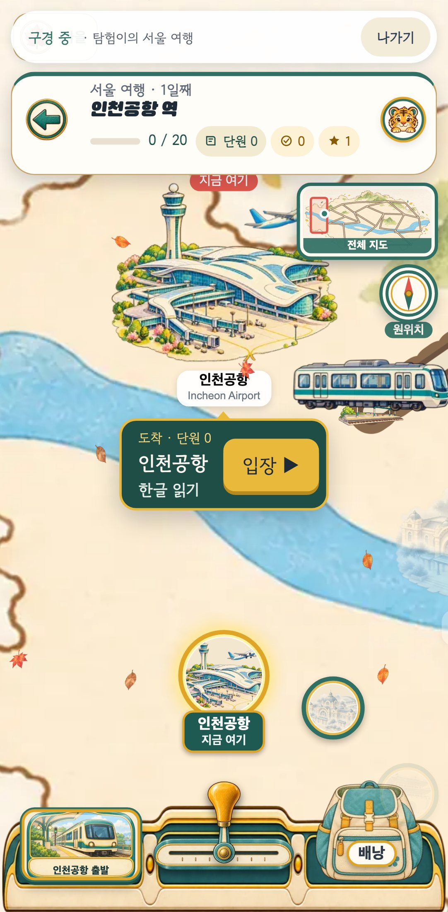
At a glance
What
A web service for learning Korean by riding a train through 20 places in Seoul
Who
Kids to people in their 30s, K-POP and K-culture fans — India first
Today
Live · 20 lessons · 461 questions · 3 interface languages
Ask
We are looking for partners to grow it in India

Slide 3
Why India, why now
1
2
3
More people want to learn Korean
The test is taken inside India
Yet few apps are built for India
Overseas King Sejong Institute learners grew from 210,374 (2024) to 239,020 (2025) — with institutes in India too.
TOPIK is held across India — Delhi, Bengaluru, Chennai, Manipur and more.
Most learning apps we reviewed are built for English-speaking markets.
Sources: Korea JoongAng Daily · Asia Economy (King Sejong Institute learners) · Korean Education Centre in India, TOPIK notices (2026). No market-size estimates are included.

Slide 4
The gap we fill
The route is the syllabus
In our review, we did not find a service that combines both.
Travel & phrase apps
Real situations, thin structure
Course-style apps
Solid structure, no situations
HangulTrip

Slide 5
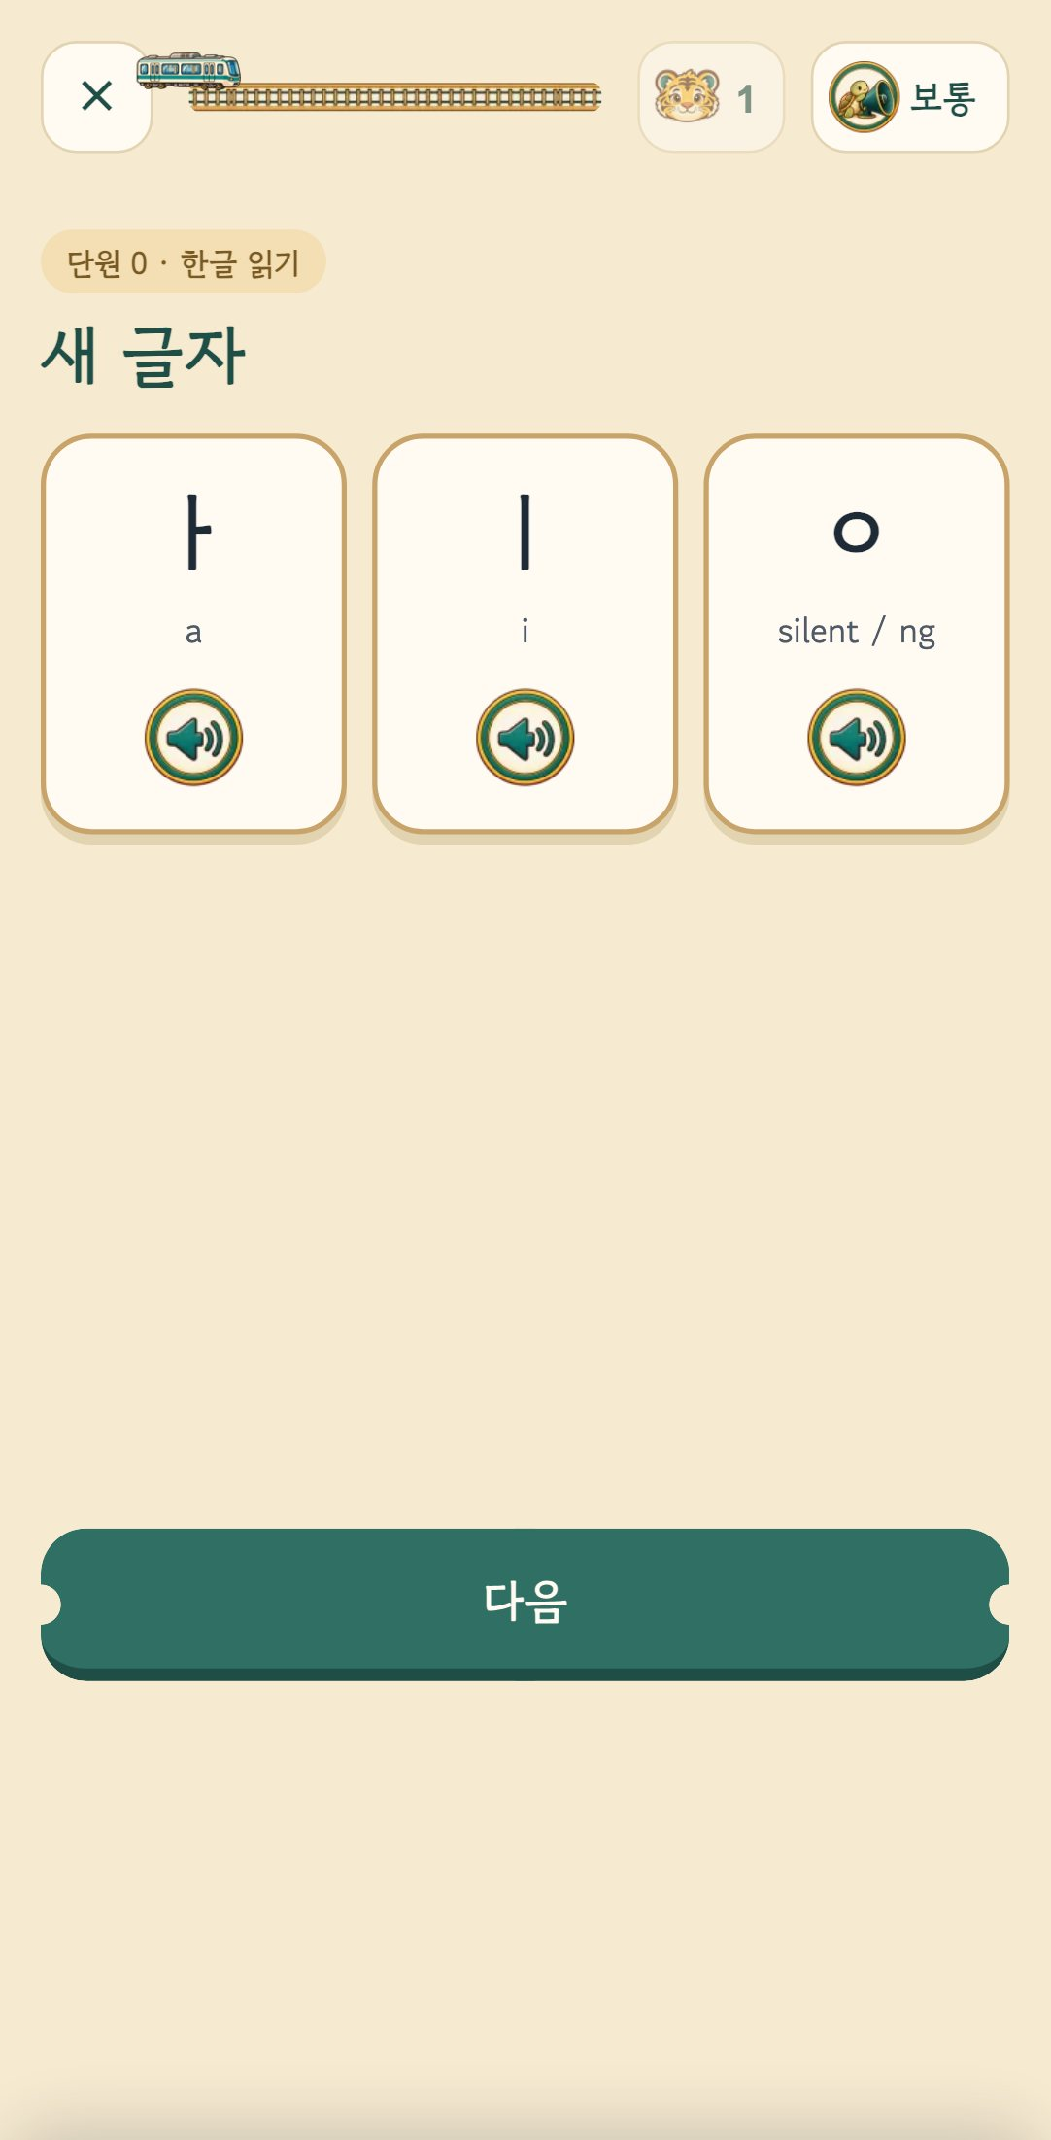
What already works today
20
461
3
3
landmarks = lessons
human-written questions
interface languages
listening speeds
Live at hangultrip.cloud — try "Look around first" without signing in.

Slide 6
Designed for India
1
Children's data first
2
Hindi interface
Built on India's DPDP Act as the floor — under-18s use no sign-in; data stays on the device.
Korean · English · Hindi — Hindi meanings for lesson words are the next step.
3
Web, no install
4
Ads only where labelled
Start from a link and add it to the home screen.
Never interrupting a lesson, and no targeted ads for under-18s.

Slide 7


Where we can work together
Local operation & reach
Schools, academies & Korean centres
Brand & destination partners
Localisation & content
Bring the service to learners in India and run it there.
A teacher-guided mode has already been designed and built (switched off for now).
Meet learners through clearly labelled partner places, in context.
Hindi meanings, native review, and content for the next cities.
The form of partnership — licensing, joint operation or local operation — is something we decide together.

Slide 8




Next steps
1
2
3
4
Explore
Talk
Pilot
Grow
Ride the train yourself at hangultrip.cloud
Agree on learners, partnership form and timeline
Start small with one school or one city
Add localisation and open the next cities

Slide 9

HangulTrip
Let’s run the Seoul train together
We would love to hear how you would like to work together.
hangultrip.cloud
hangultrip@gmail.com
Point your phone camera to open

