Slide 1
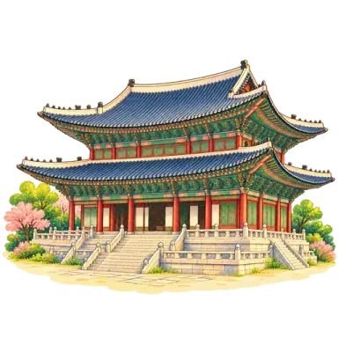
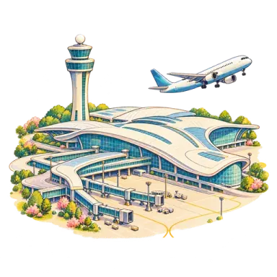

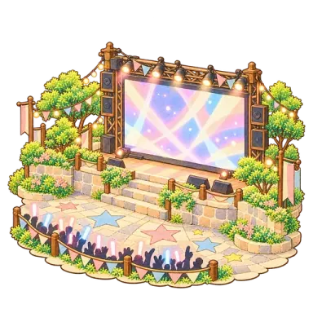

HangulTrip
Service Introduction
Learn Hangul by train across Seoul
hangultrip.cloud

Slide 2
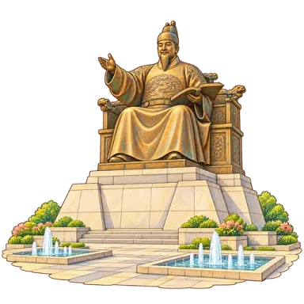
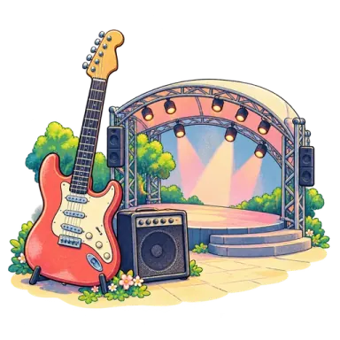
Learn like you travel, one station at a time
Twenty Seoul landmarks are twenty lessons. Finish one and the train leaves for the next station.
Unit 0
Unit 1
Unit 2
Unit 3
Unit 4
Incheon Airport
Gwanghwamun Square
Yeouido Hangang Park
Hongdae
Gyeongbokgung
1
Start by reading Hangul at Incheon Airport
2
At every landmark, the words you would use there
3
Finish, and depart for the next station

Slide 3
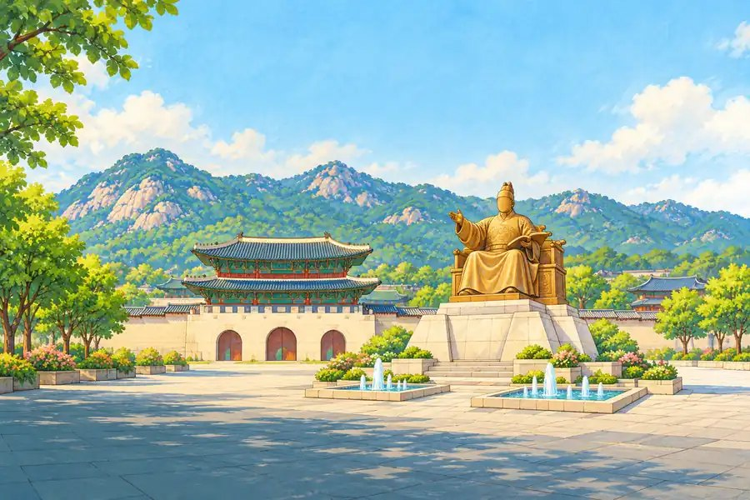

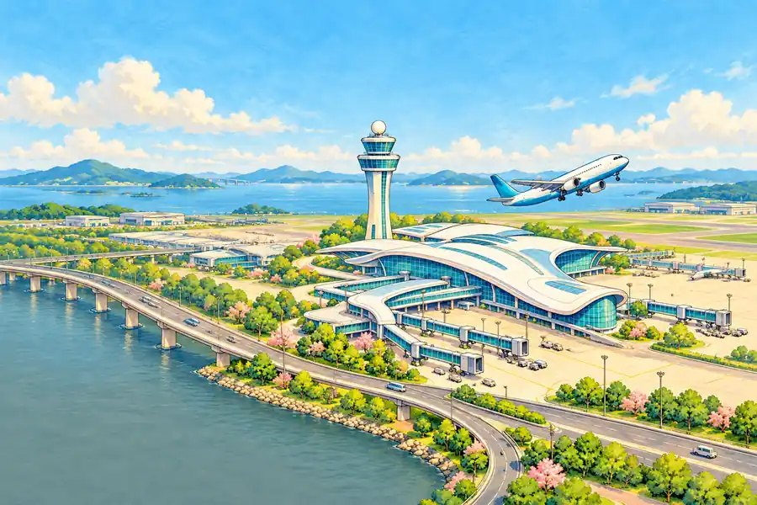
Who it is for
Kids to people in their 30s
Fans of K-POP and Korean culture
India first
No grades or terms — just region, city and station.
Songs, streets, palaces and markets — learn in the Seoul you love.
The app speaks Korean, English and Hindi.

Slide 4
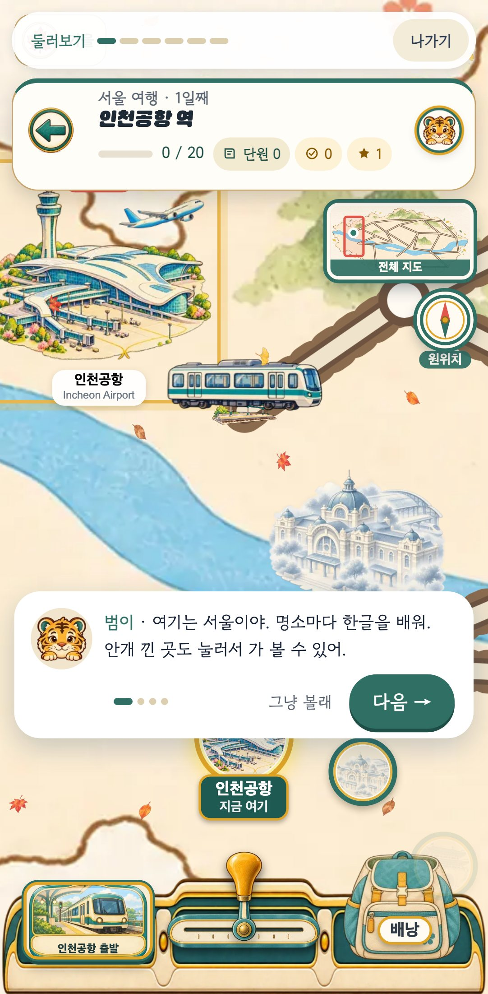
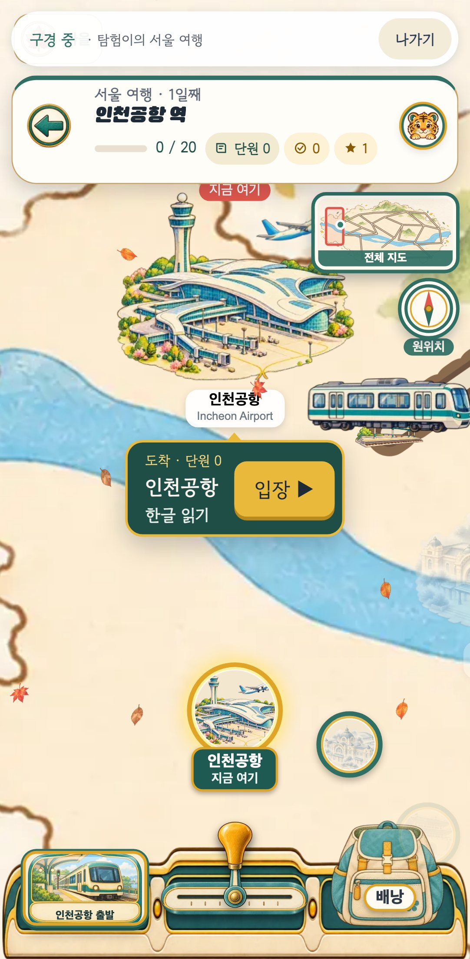
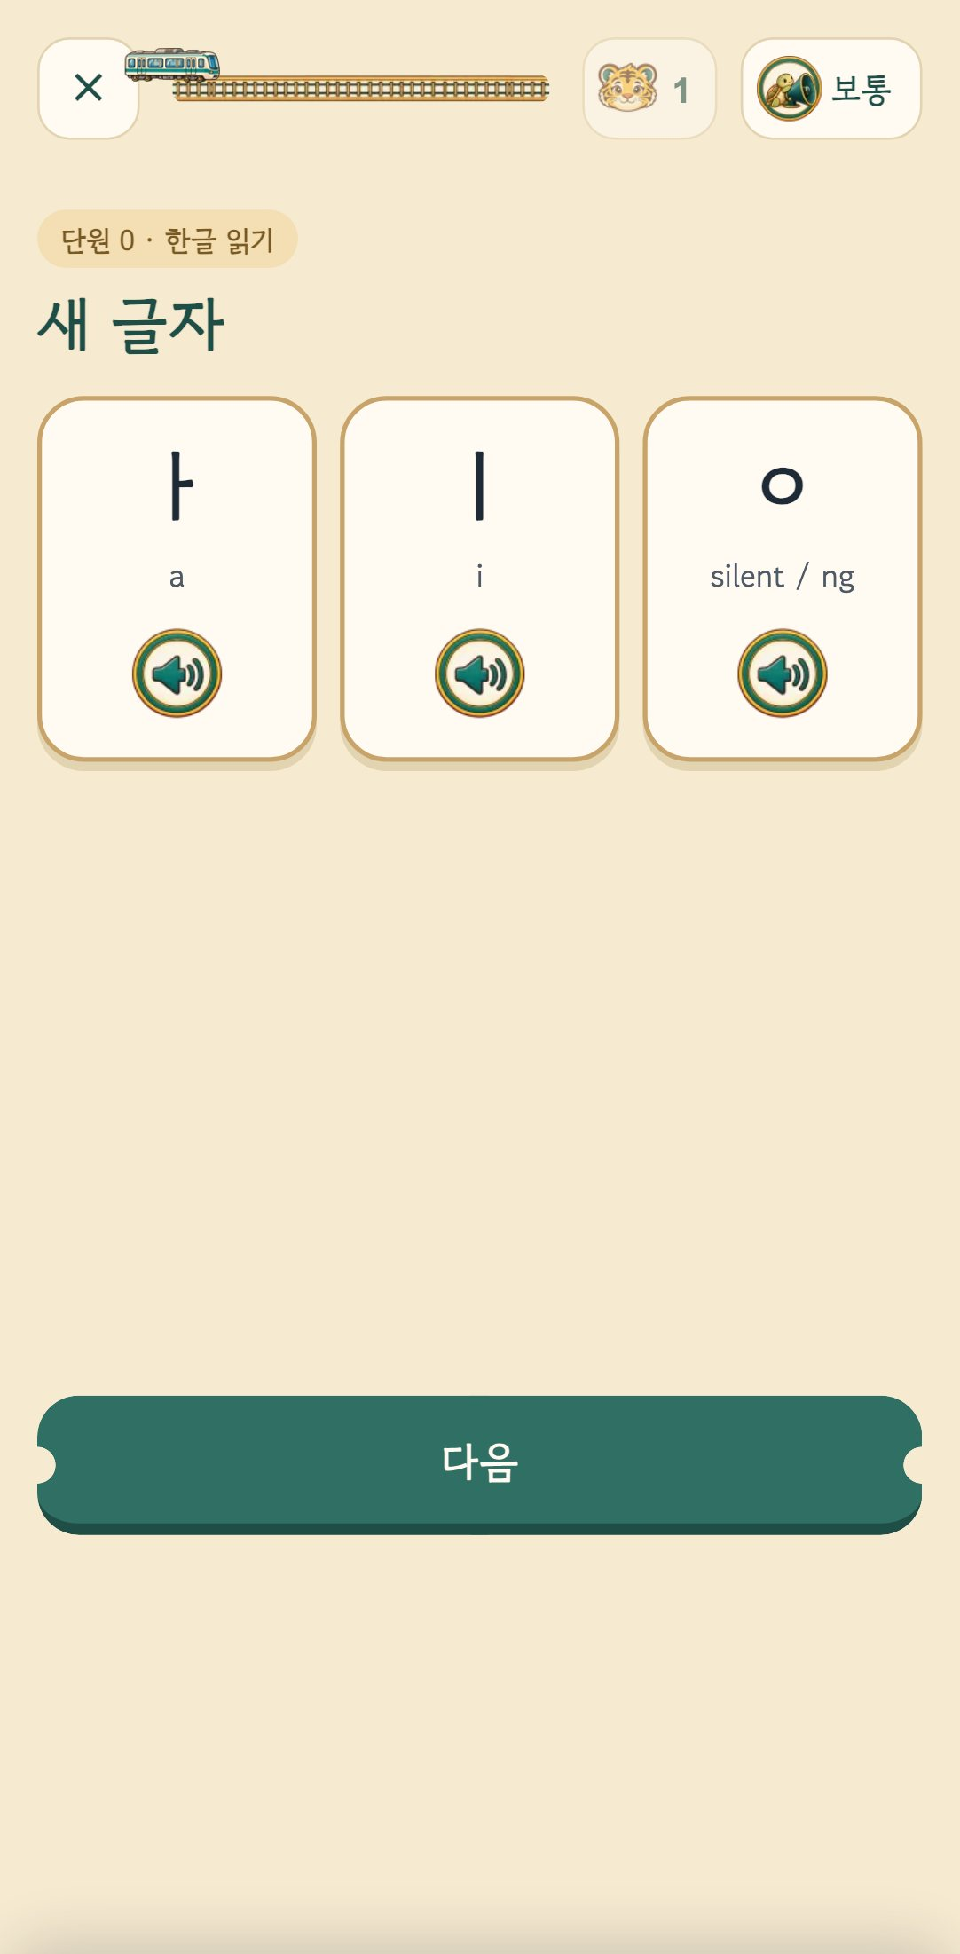
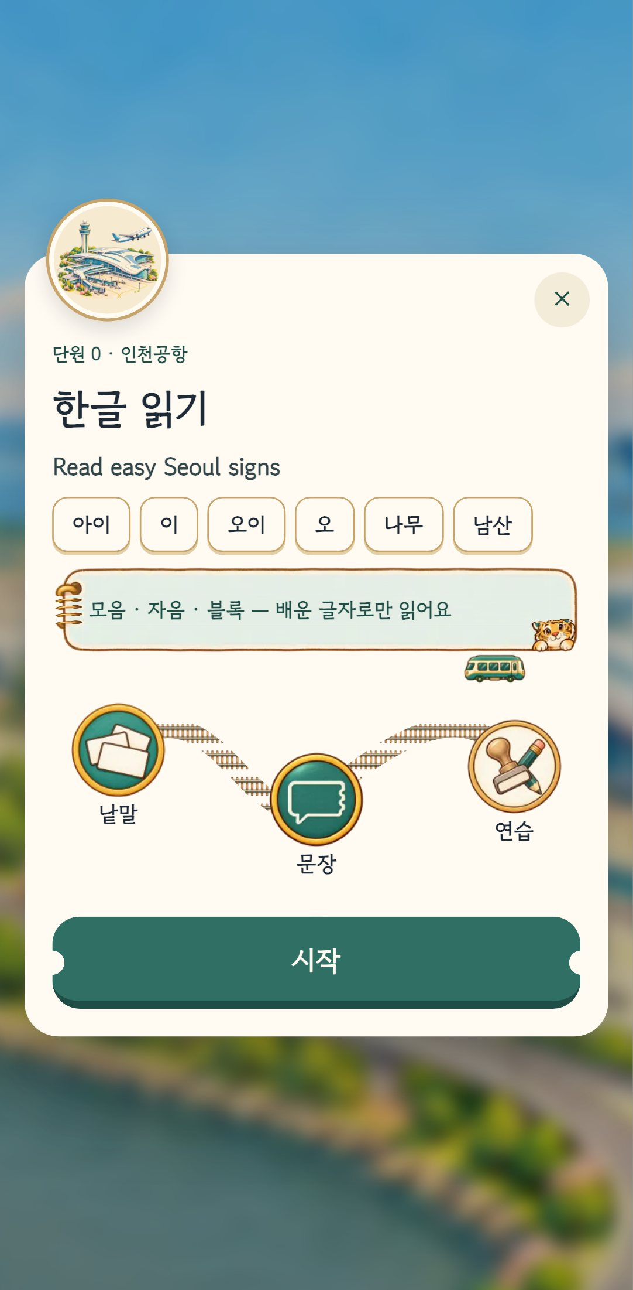
A day on the trip
Arrive → one lesson → next station. Learners finish on their own.
1
Seoul train map
2
Arrival card · enter
3
Words → sentences → practice
4
Stamp pieces + landmark card

Slide 5
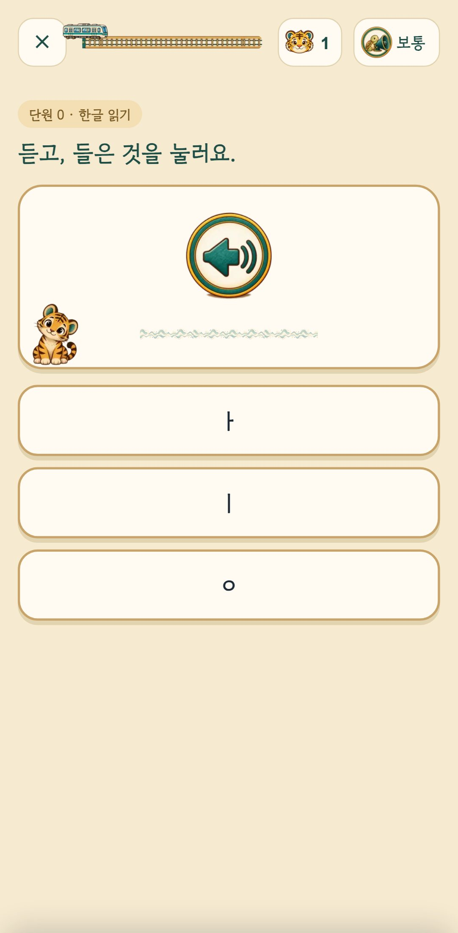
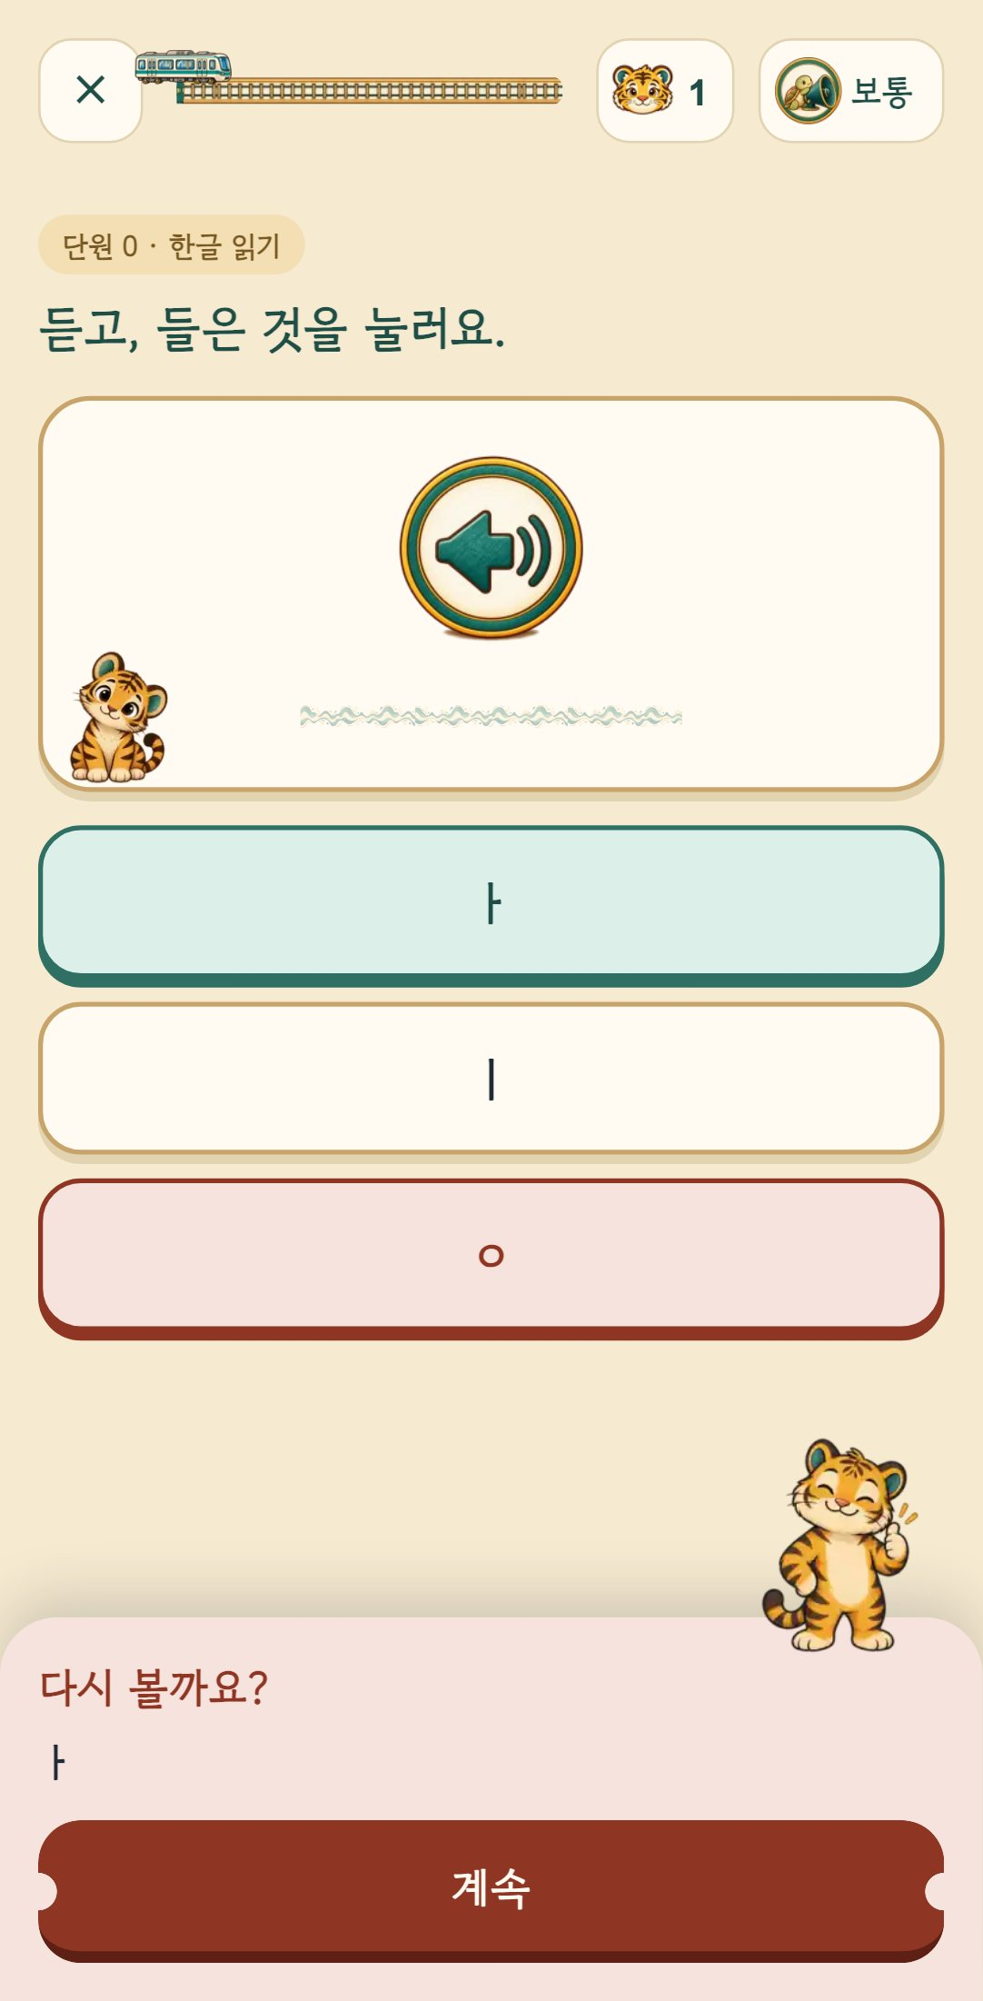
Every lesson has three stops
1
Words
See and hear new letters and words
2
Sentences
Sentences with meaning on every piece
3
Practice
Listen & choose · fill the blank · put in order
Three listening speeds — normal · slow · one syllable at a time
No red X. A gentle "Shall we look again?" and you simply choose again.

Slide 6
Hangul starts at the airport
Not in dictionary order — in the order that lets you read something from the very first screen.
ㅏ ㅣ ㅇ
ㅗ ㅜ ㅡ
ㄴ ㅁ ㅅ
ㅓ ㄹ ㄱ
ㅎ ㄷ ㅂ
아이
오이
남산
서울
한강
child
cucumber
Namsan
Seoul
Han River
Only words made of letters already learned appear.

Slide 7
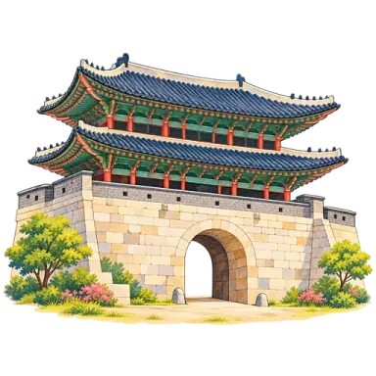



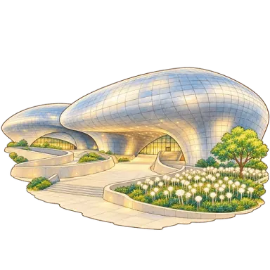



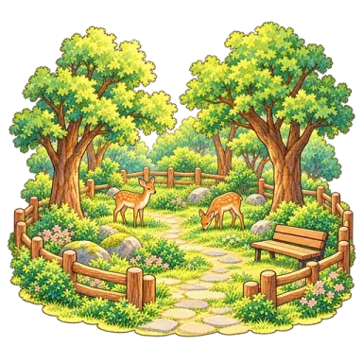
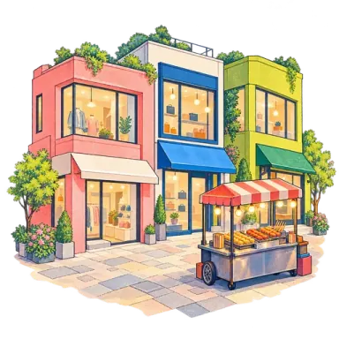
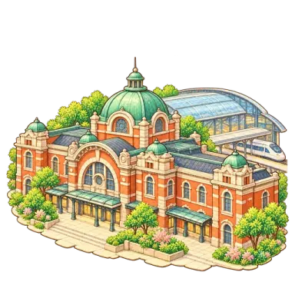
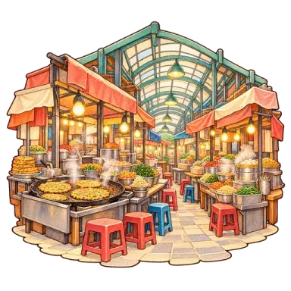
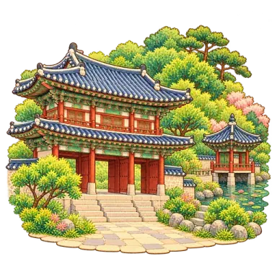
20 stations, 20 lessons
The route is the syllabus: situational conversation in units 1–17, with two review stops.
Unit 0 Incheon Airport
Read easy Seoul signs
Unit 5 Sungnyemun
Ask the way · subway
Unit 10 Lotte World Tower
Talk about plans
Unit 13 Cheonggyecheon
Ask and give directions
Unit 1 Gwanghwamun Square
Greet and introduce yourself
Unit 6 Insadong
Order what you want
R1 DDP
Review units 1–5
Unit 14 Seongsu
Say what you want to do
Unit 2 Yeouido Hangang Park
Ask and say what this is
Unit 7 Bukchon Hanok Village
Ask about times
R2 Gangnam / COEX
Review units 6–10
Unit 15 Seoul Forest
Weather and seasons
Unit 3 Hongdae
Say where you are going
Unit 8 Myeongdong
Ask and pay prices
Unit 11 Seoul Station
Buy tickets · count
Unit 16 K-POP Street
What you like · cheering
Unit 4 Gyeongbokgung
Ask where things are
Unit 9 N Seoul Tower
Say what you did
Unit 12 Gwangjang Market
Order food · taste
Unit 17 Changdeokgung
Polite greetings

Slide 8


Souvenirs, not penalties
Stamp pieces & landmark cards
Collected in a travel passport at every finished stop.
Today's postcard
Decorate a landmark postcard and share it — no name, face or age on it.
This week's attendance
Miss a day and lose nothing — so you come back.

Slide 9
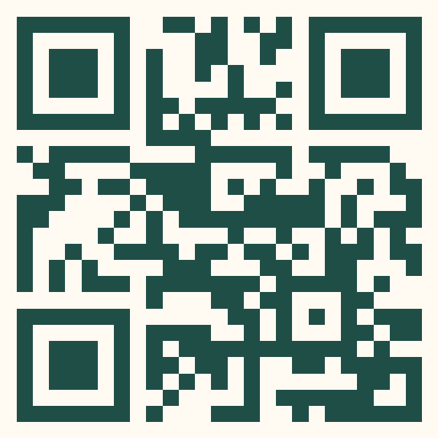
Safe by design, for kids too
Under 18: no sign-in
No birthdate, face or name
No paid luck
Progress stays on the device and is never sent to a server.
Age is only "18 or older / under 18".
No gacha. Cards come only from what you do.
Written by people, graded by code
No real brands, singers or faces
Chosen on the very first screen —
"18 or older" · "under 18"
AI never invents questions or answers on the fly.
K-POP is drawn with light sticks and stage lights only.

Slide 10
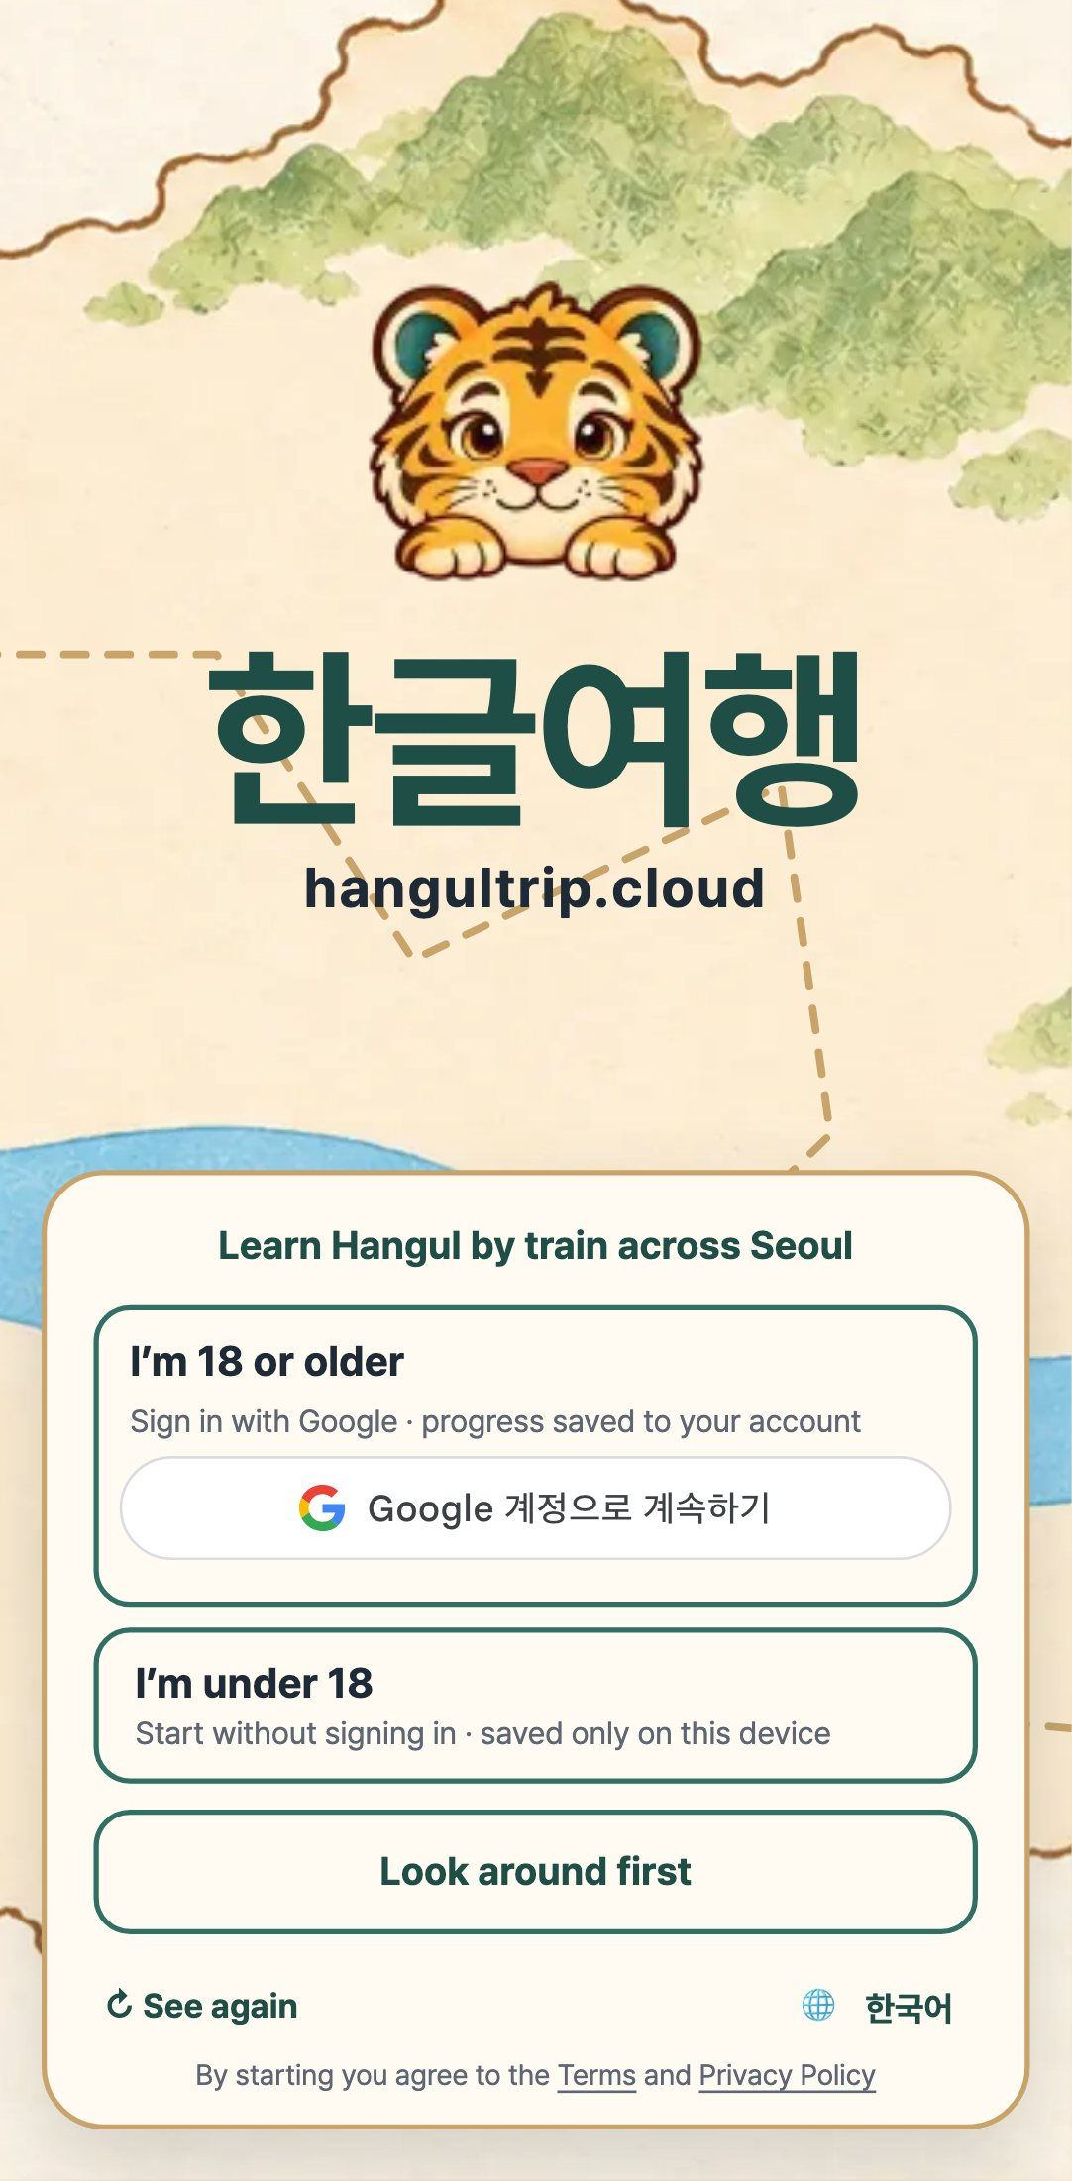
Light on any phone
1
Runs in the browser — no install · add to home screen like an app
2
Train controls tuned for phone, tablet and PC
3
Pre-recorded audio for every sentence
4
Interface: Korean · English · Hindi

Slide 11
After Seoul
Seoul is the first region. The same engine opens the next cities.
Busan
Gyeongju
Jeju
Jeonju
Gangneung
Seoul · open
coming
coming
coming
coming
coming
More real-world question types are coming — reading a convenience-store shelf, a menu board.

Slide 12
HangulTrip
Start your trip now
Tap "Look around first" to explore without signing in.
hangultrip.cloud
hangultrip@gmail.com
Point your phone camera to open

